Slide 1
Group Name - Ankit Kumar
Name - Ankit Kumar
3rd Year Btech Student at BIT Mesra
Topic – Exploratory Data Analysis on Global terrorism Database

Slide 2
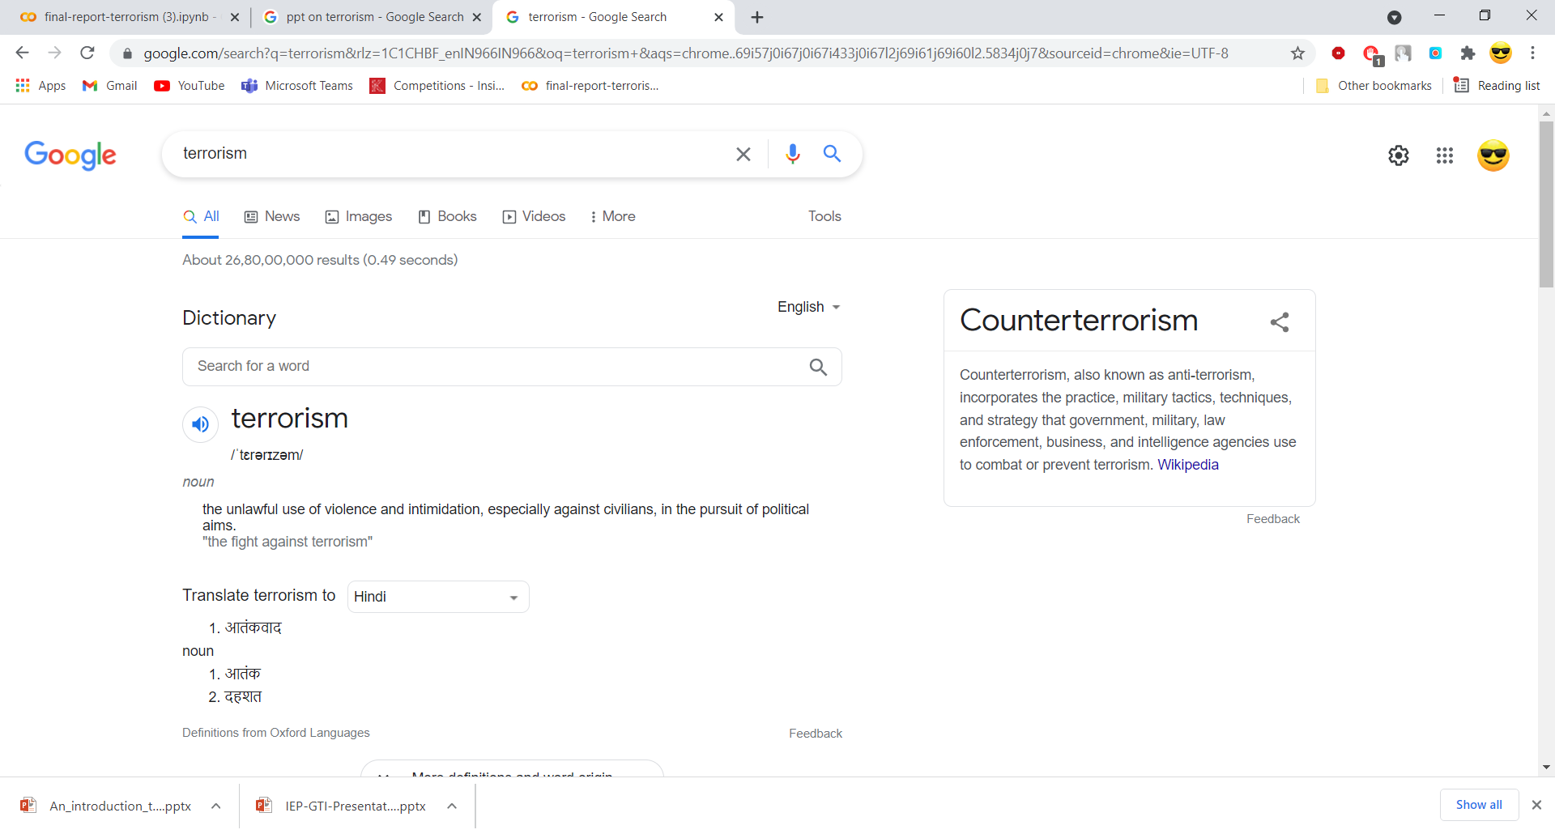
Terrorism
IN SHORT, TERRORISM IS A FORM OF PSYCHOLOGICAL ASSAULT, OR WARFARE, THAT WEAPONIZES THE EMOTIONS, MOST NOTABLY FEAR AND OUTRAGE.
The topic of terrorism is both complex and emotive. It is complex because it combines so many different aspects of human experience, including subjects such as politics, psychology, philosophy, military strategy, and history, to name a few. Terrorism is also emotive both because experiences of terrorist acts arouse tremendous feelings, and because those who see terrorists as justified often have strong feelings concerning the rightness of the use of violence. Without a doubt, terrorism evokes strong feelings whenever it is discussed. A key challenge of understanding terrorism is both acknowledging the moral outrage at terrorist acts, while at the same time trying to understand the rationale behind terrorism.

Slide 3
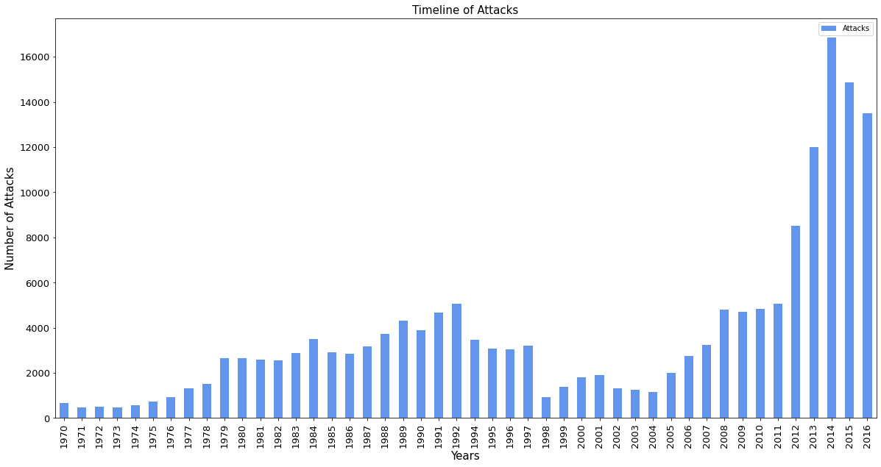
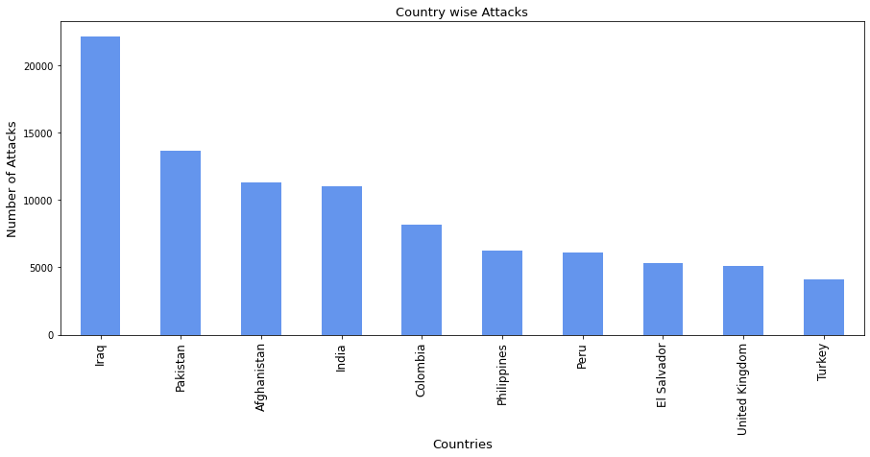
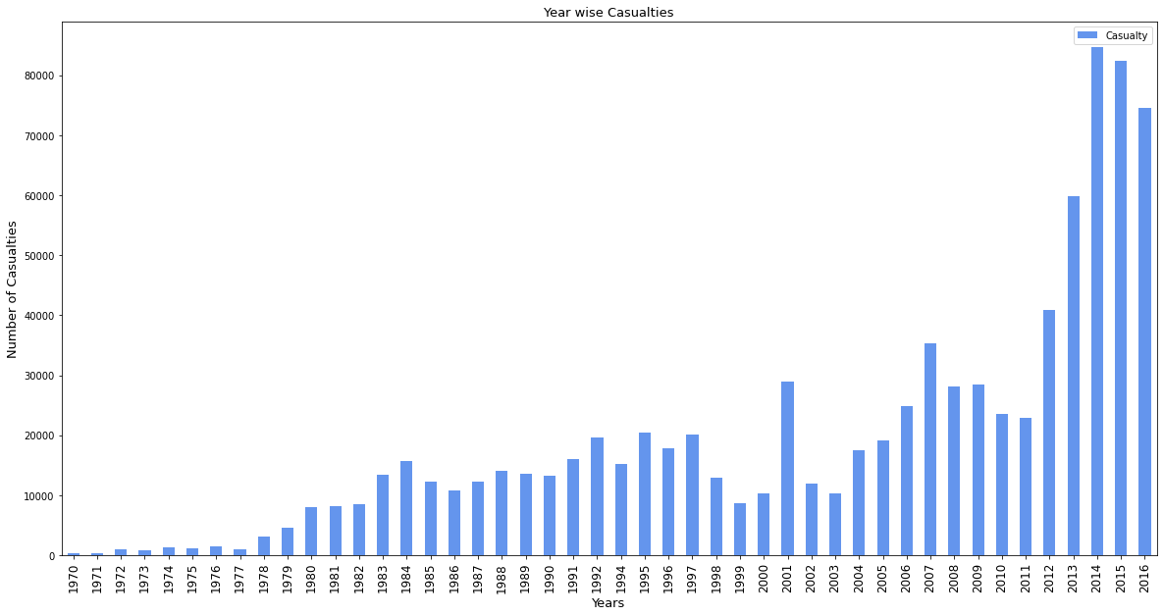
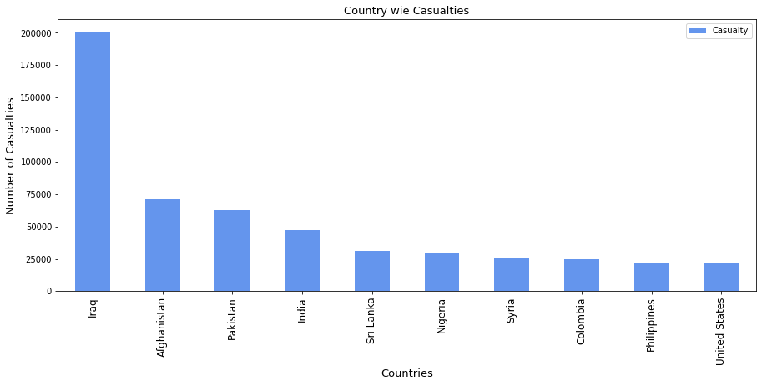
Year Wise Analysis
Country Wise Analysis

Slide 4
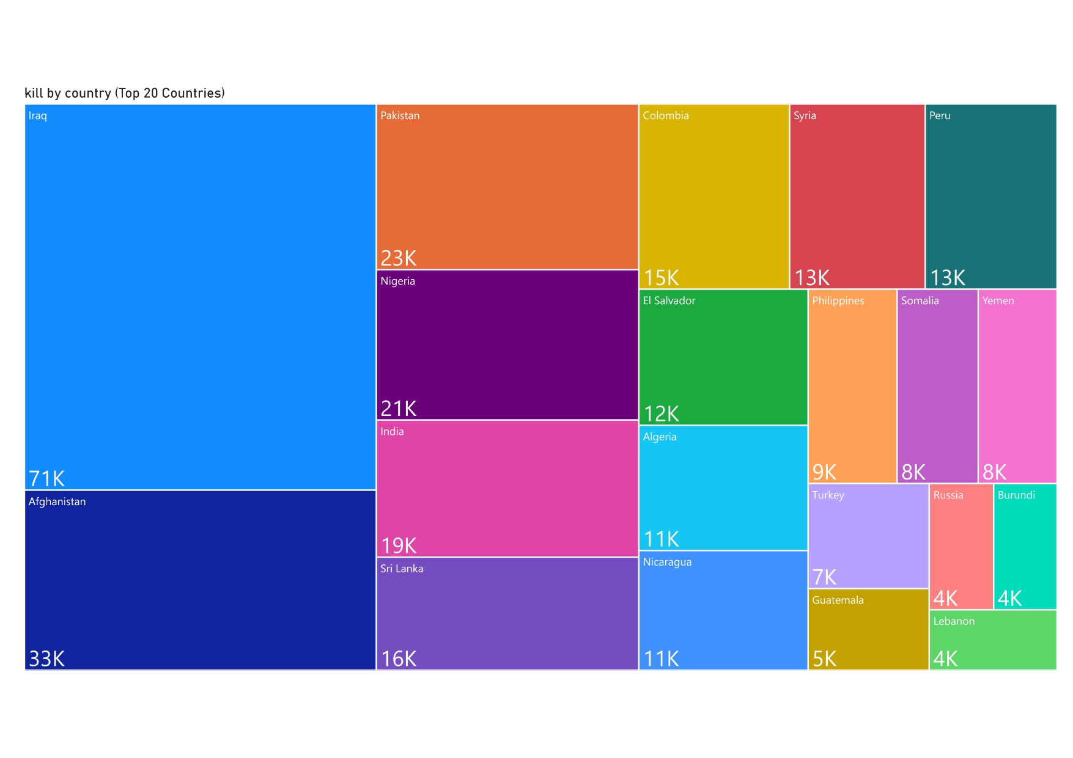
Fatality count (Top 20 Countries)

Slide 5
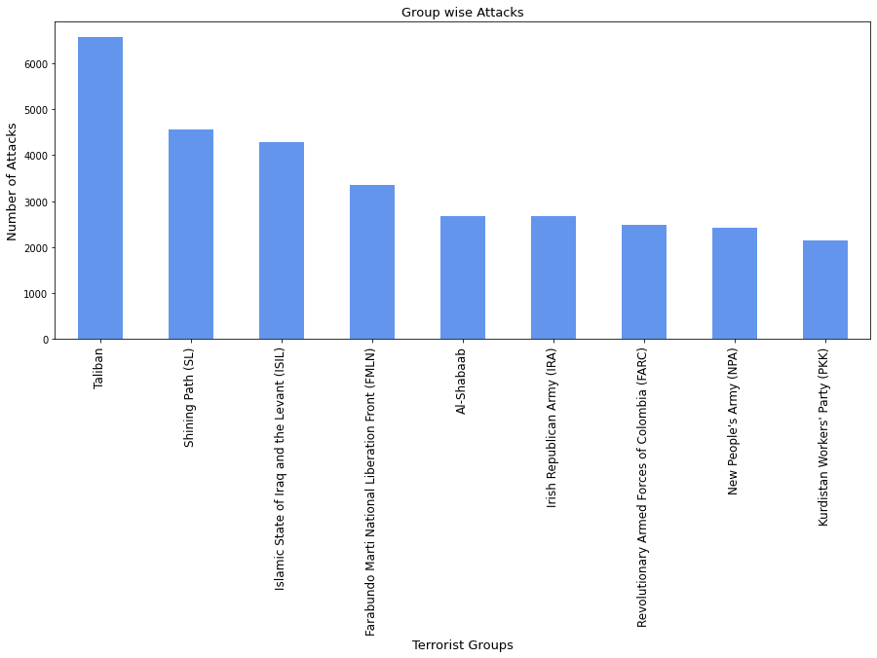
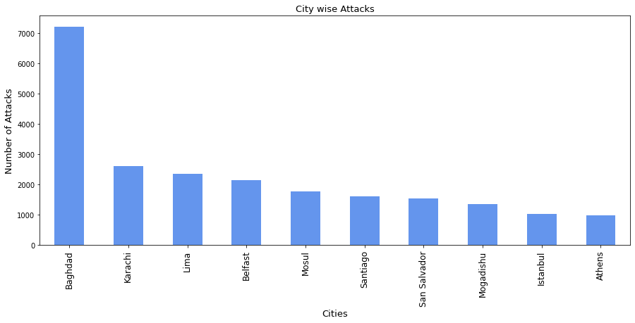
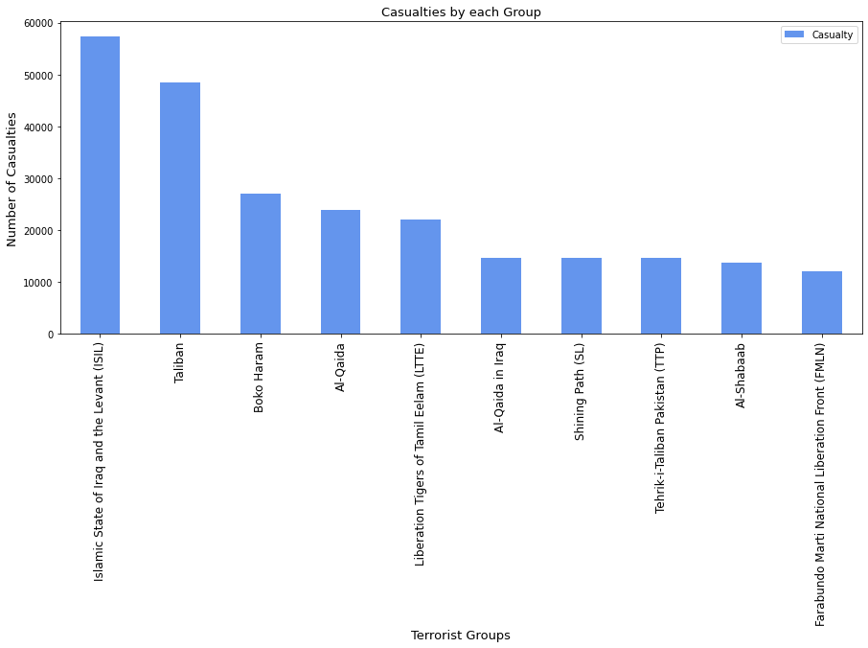
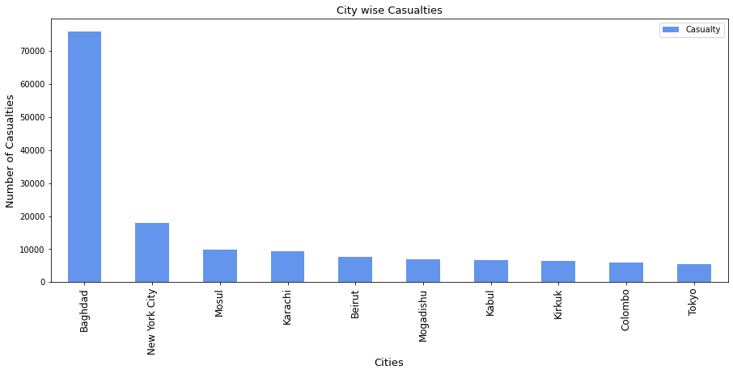
Terrorist Groupwise Attacks
City Wise Analysis

Slide 6
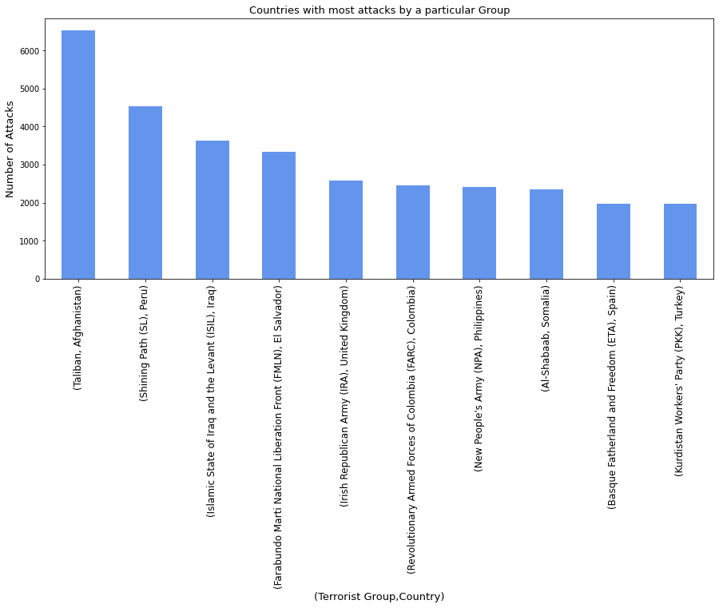
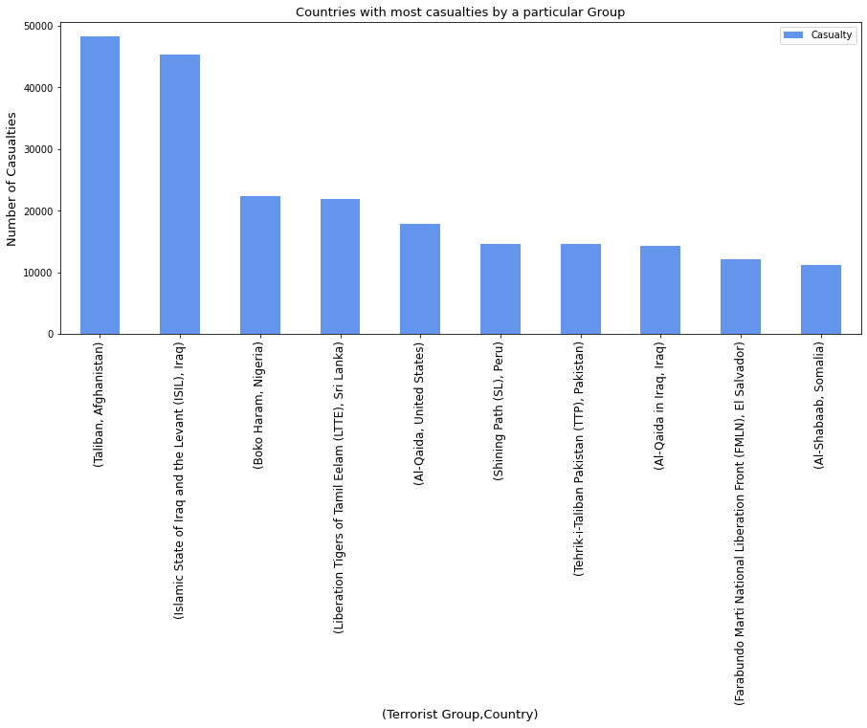
Country-Terrorist Grp wise analysis types
Group Name | Country | Casualty
Taliban | Afghanistan | 48231.0
Islamic State of Iraq and the Levant (ISIL) | Iraq | 45292.0
Boko Haram | Nigeria | 22353.0
Liberation Tigers of Tamil Eelam (LTTE) | Sri Lanka | 21918.0
Al-Qaida | United States | 17840.0
Shining Path (SL) | Peru | 14619.0
Tehrik-i-Taliban Pakistan (TTP) | Pakistan | 14537.0
Al-Qaida in Iraq | Iraq | 14301.0
Farabundo Marti National Liberation Front (FMLN) | El Salvador | 12068.0
Al-Shabaab | Somalia | 11119.0

Slide 7
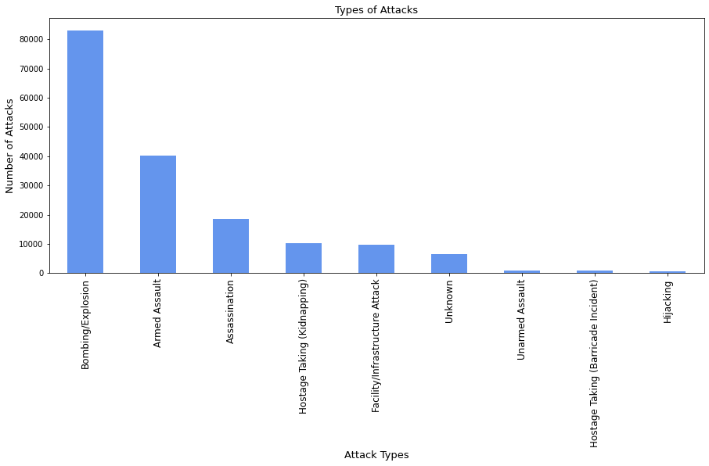
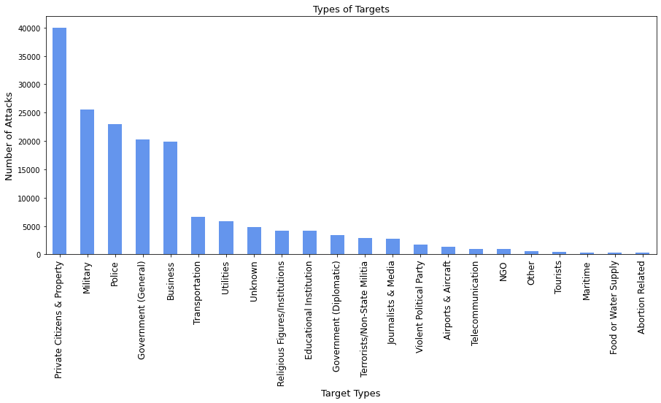
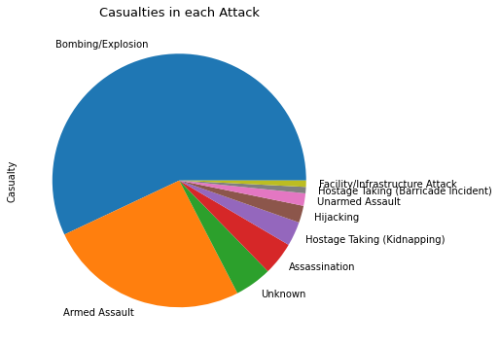
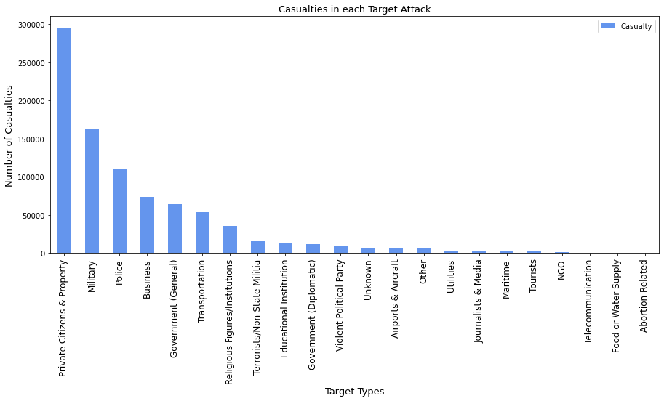
Target types analysis
Attack types analysis

Slide 8
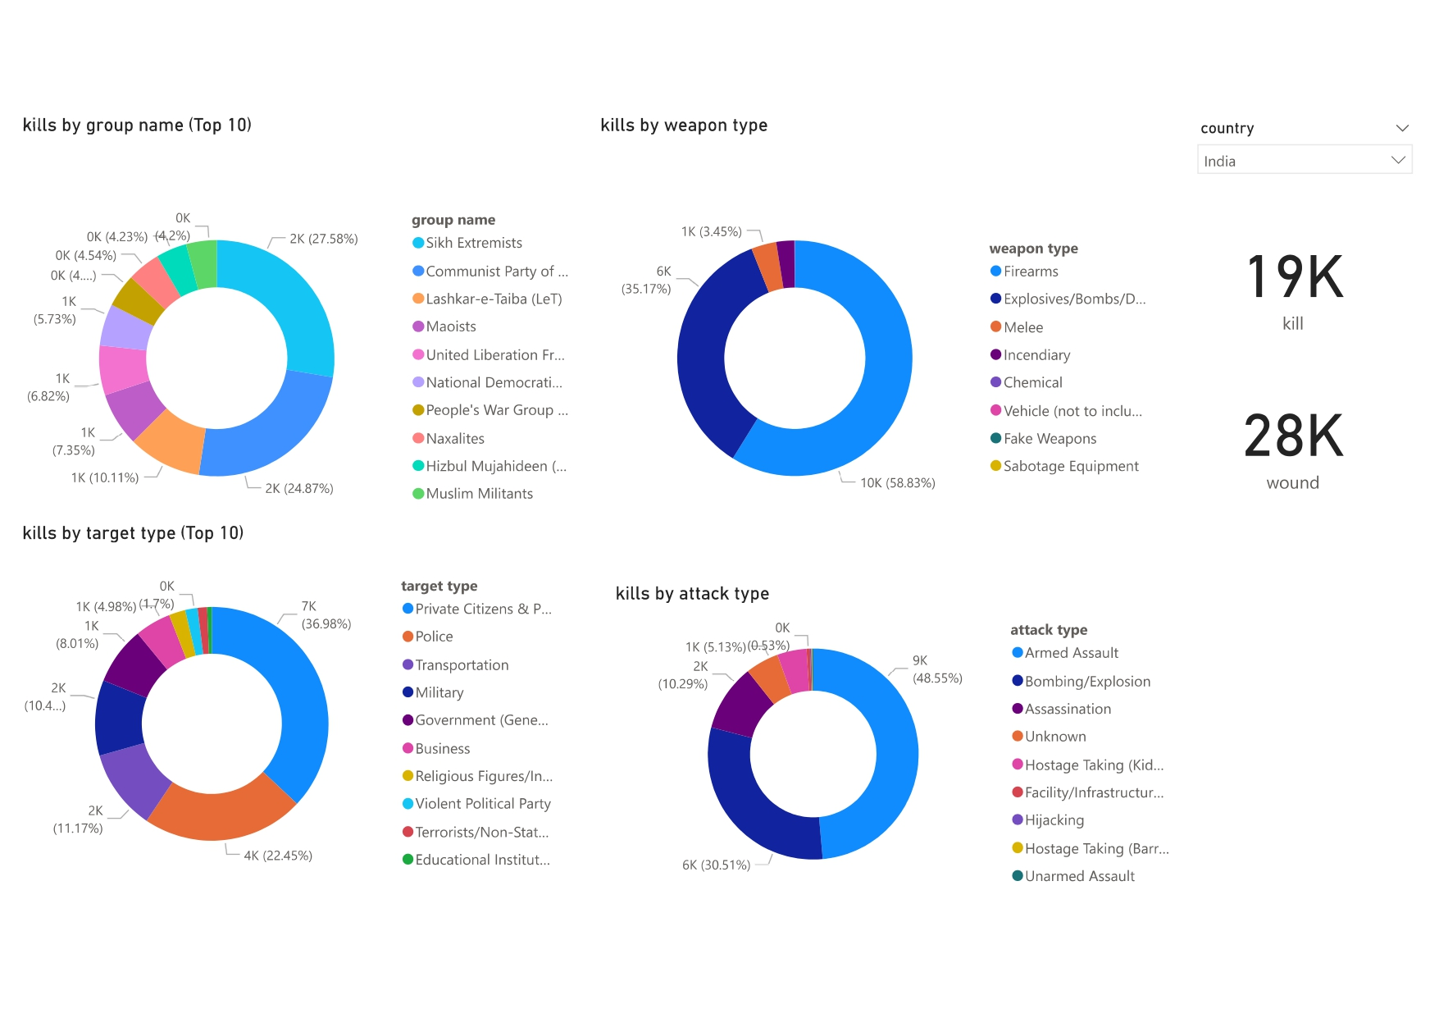
Terrorism India

Slide 9
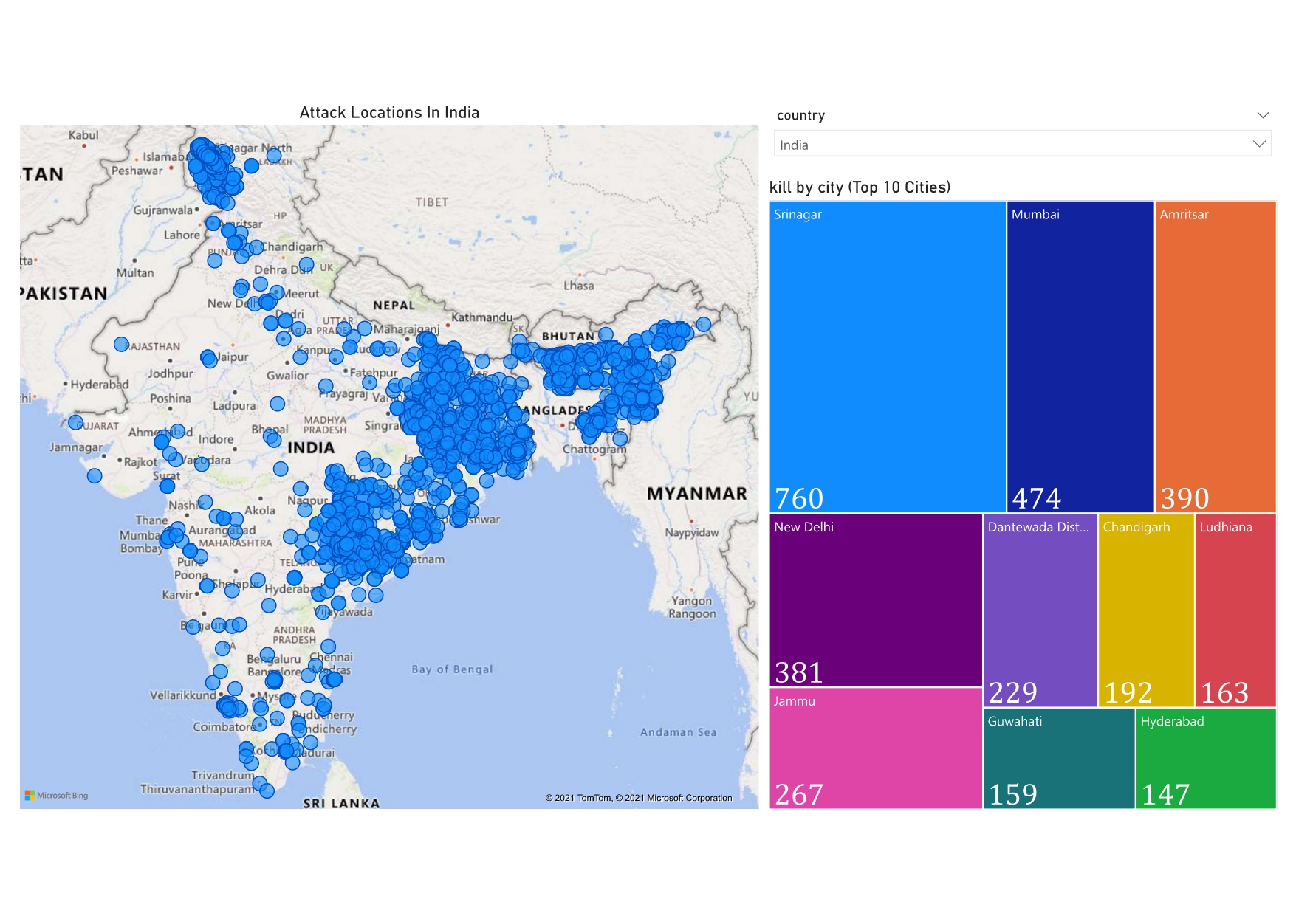
Terrorist Attack in India

Slide 10
Top 10 Terrorist Events (World)
Year | Country | City | Kills | Attack Type | Group Name
2014 | Iraq | Tikrit | 1500 | Hostage Taking (Kidnapping) | Islamic State of Iraq and the Levant (ISIL)
2001 | United States | New York City | 1383 | Hijacking | Al-Qaida
2001 | United States | New York City | 1382 | Hijacking | Al-Qaida
1994 | Rwanda | Gikoro | 1180 | Armed Assault | Hutu extremists
2014 | Iraq | Badush | 670 | Armed Assault | Islamic State of Iraq and the Levant (ISIL)
2004 | Nepal | Dhading district | 518 | Armed Assault | Communist Party of Nepal- Maoist (CPN-M)
2014 | Syria | Unknown | 517 | Hostage Taking (Kidnapping) | Islamic State of Iraq and the Levant (ISIL)
2014 | Iraq | Sinjar | 500 | Hostage Taking (Kidnapping) | Islamic State of Iraq and the Levant (ISIL)
2016 | Syria | Palmyra | 433 | Hostage Taking (Kidnapping) | Islamic State of Iraq and the Levant (ISIL)
1978 | Iran | Abadan | 422 | Facility/Infrastructure Attack | Mujahedin-e Khalq (MEK)
Top 10 Terrorist Events (India)
Year | City | Kills | Attack Type | Group Name
2006 | Mumbai | 188 | Bombing/Explosion | Lashkar-e-Taiba (LeT)
1992 | Bombay | 115 | Armed Assault | Muslim Militants
2010 | Jhargam | 115 | Unknown | Communist Party of India - Maoist (CPI-Maoist)
2010 | Dantewada district | 82 | Armed Assault | Communist Party of India - Maoist (CPI-Maoist)
1994 | Banabari | 70 | Armed Assault | Bodo Militants
2008 | Mumbai | 68 | Hostage Taking (Kidnapping) | Deccan Mujahideen
2007 | Diwana | 66 | Bombing/Explosion | Unknown
1991 | Baddowal | 62 | Armed Assault | Sikh Extremists
1992 | Unknown | 61 | Unknown | Muslims
1997 | Bathe-Lakshmanpur | 60 | Armed Assault | Ranbir Sena
2008 | Mumbai | 58 | Armed Assault | Deccan Mujahideen

Slide 11
Thank You

